Slide 1
Introduction to Power BI
© 2022 Microsoft. All rights reserved.

Slide 2
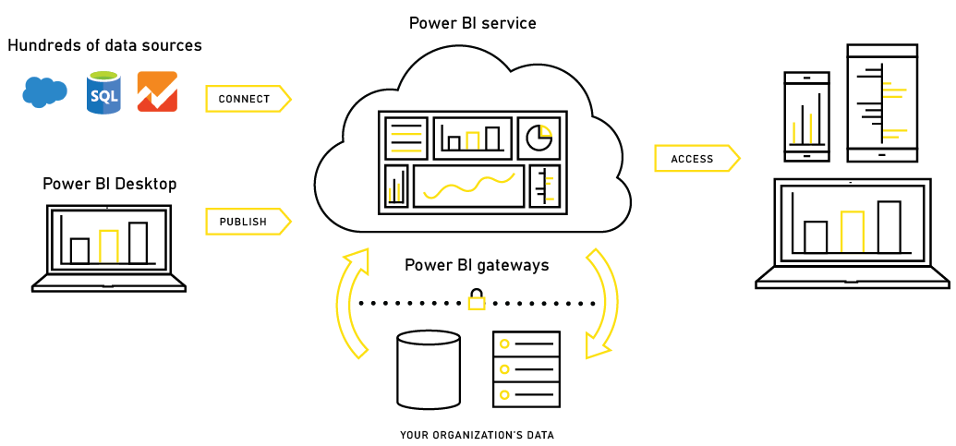
Power BI – Experience Your Data
Any data, any way, anywhere
© 2022 Microsoft. All rights reserved.

Slide 3
Tools
Power BI Desktop
Query Editor
Data Modeling
Visualization
Power BI Service
Datasets
Reports
Dashboards
Workspaces
Apps
Dataflows
© 2022 Microsoft. All rights reserved.

Slide 4
Demo
Introduction to Power BI
© 2022 Microsoft. All rights reserved.

Slide 5
Understanding the Power BI Administrator Role
© 2022 Microsoft. All rights reserved.

Slide 6

Are you a Steward or a Captain
Self Service
Enterprise
Power BI steward
Monitors the users in a Power BI environment.
Establishes processes, policies, and guidelines to help users take the right actions in compliance with local and international laws as well as organizational policies.
Moves the organization towards a culture that views data as a competitive asset.
 | Power BI captain
 | Responsible for the safe and efficient operation of a Power BI environment.
 | Limits what users can do in a Power BI environment to ensures compliance with local and international laws as well as organizational policies.
 | Cares about all resources/solutions in the Power BI environment. It doesn’t matter what resources/solutions are shared with the admin’s user account.
© 2022 Microsoft. All rights reserved.

Slide 7
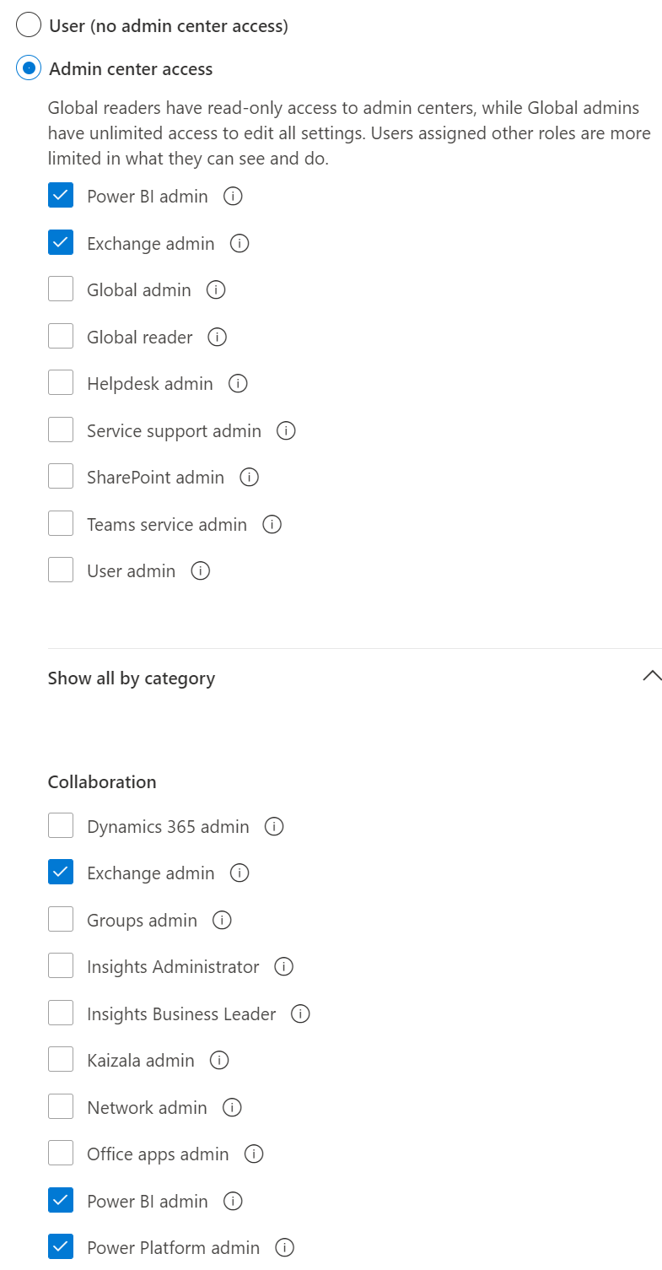
Power BI Administrator Role
No admin perms needed to register Apps!
Administrator type | Scope
Office 365 Global Administrator | Office 365
Office 365 Billing Administrator | Office 365
Power BI Service Administrator | Power BI
Power BI Capacity Administrator | A single capacity (Premium or Azure)
Power BI App Workspace Administrator | A single app workspace
Power Platform Service Administrator | Power Platform
© 2022 Microsoft. All rights reserved.

Slide 8
Typical Admin Tasks
Global Admin
Assigning licenses
Audit logging
Power Platform Administrator
Manage Gateways (coming soon)
Power BI Administrator
Controlling access
Controlling Power BI tenant features
Manage Gateways
Activity Log
Monitoring usage
© 2022 Microsoft. All rights reserved.

Slide 9
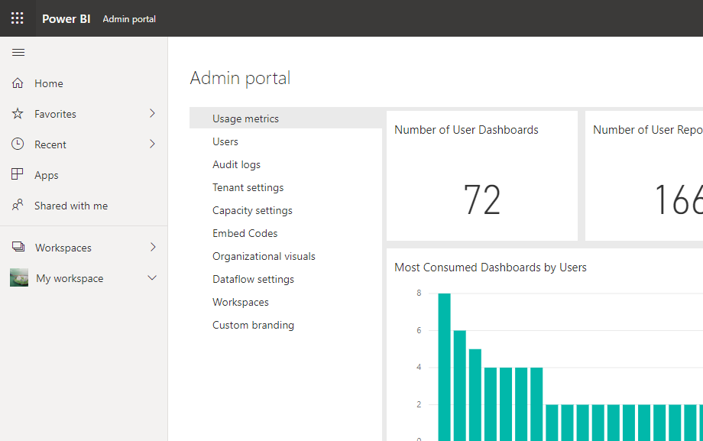
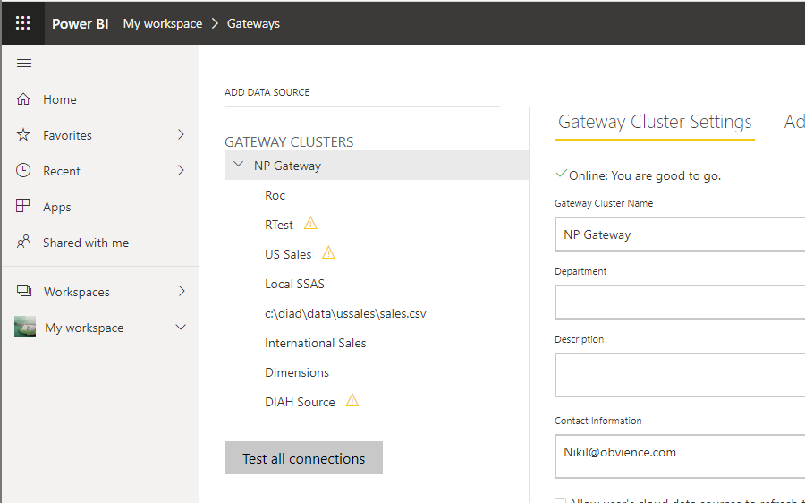
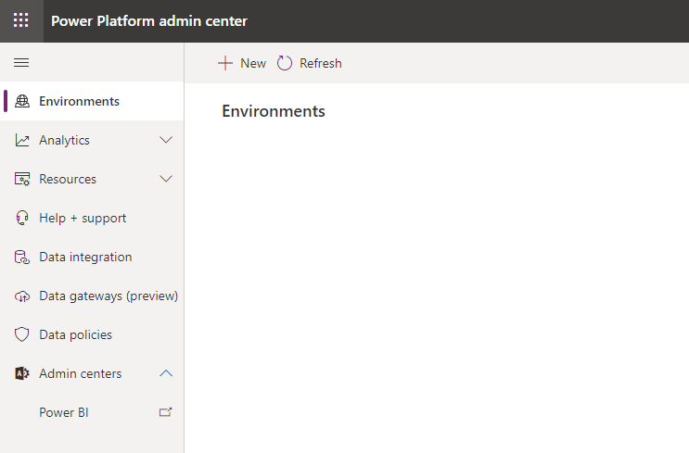
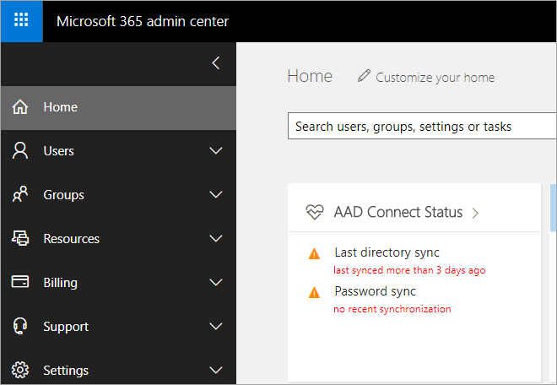
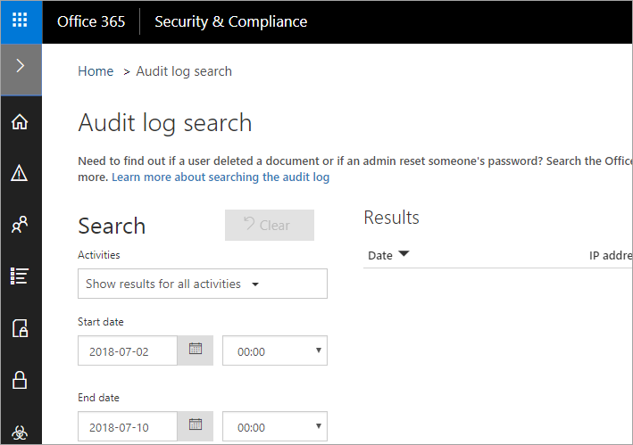
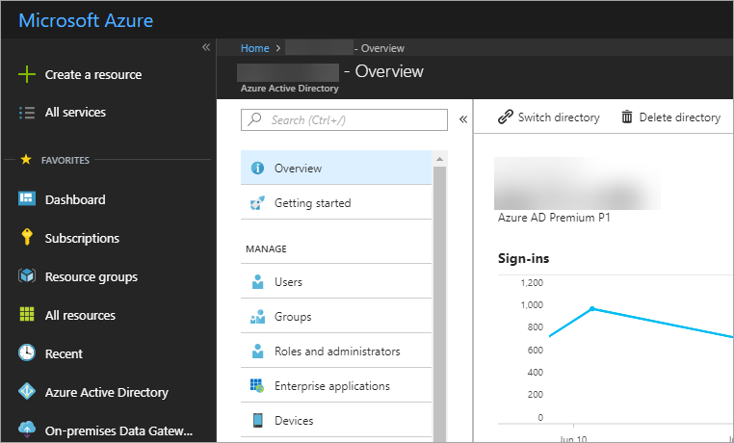
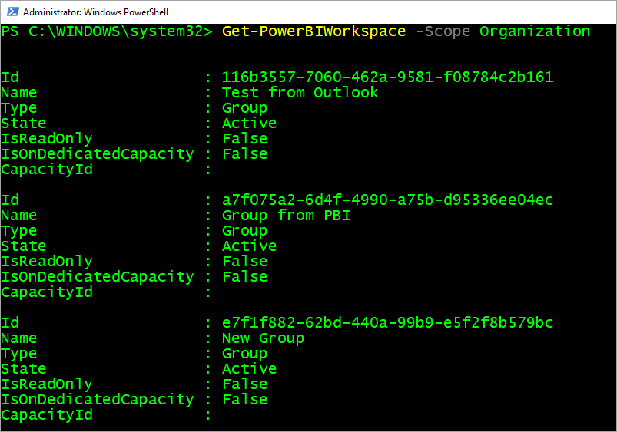
Typical Admin Tools
Power BI Admin Portal
Power BI Gateway Management
Power Platform Admin Center
Microsoft 365 Admin Center
Security & Compliance Center
Azure Active Directory Portal
PowerShell
REST APIs
© 2022 Microsoft. All rights reserved.

Slide 10
Providing Governance in a Power BI Environment
© 2022 Microsoft. All rights reserved.

Slide 11
Role of Administration and Governance
IT / BI Teams
Business Users
Data Engineering
Enterprise Reporting
Requirements Gathering
Ad hoc analysis and reporting
Collaboration
Central IT
Training and Education
Data Governance
Enabling Business Process & Access control
Procurement & Administration
© 2022 Microsoft. All rights reserved.

Slide 12
Elements of Data Governance
Visibility
Control
Compliance
Understand system state and activity
Enforce policies for use of the system
Configure the system to achieve compliance requirements
© 2022 Microsoft. All rights reserved.

Slide 13
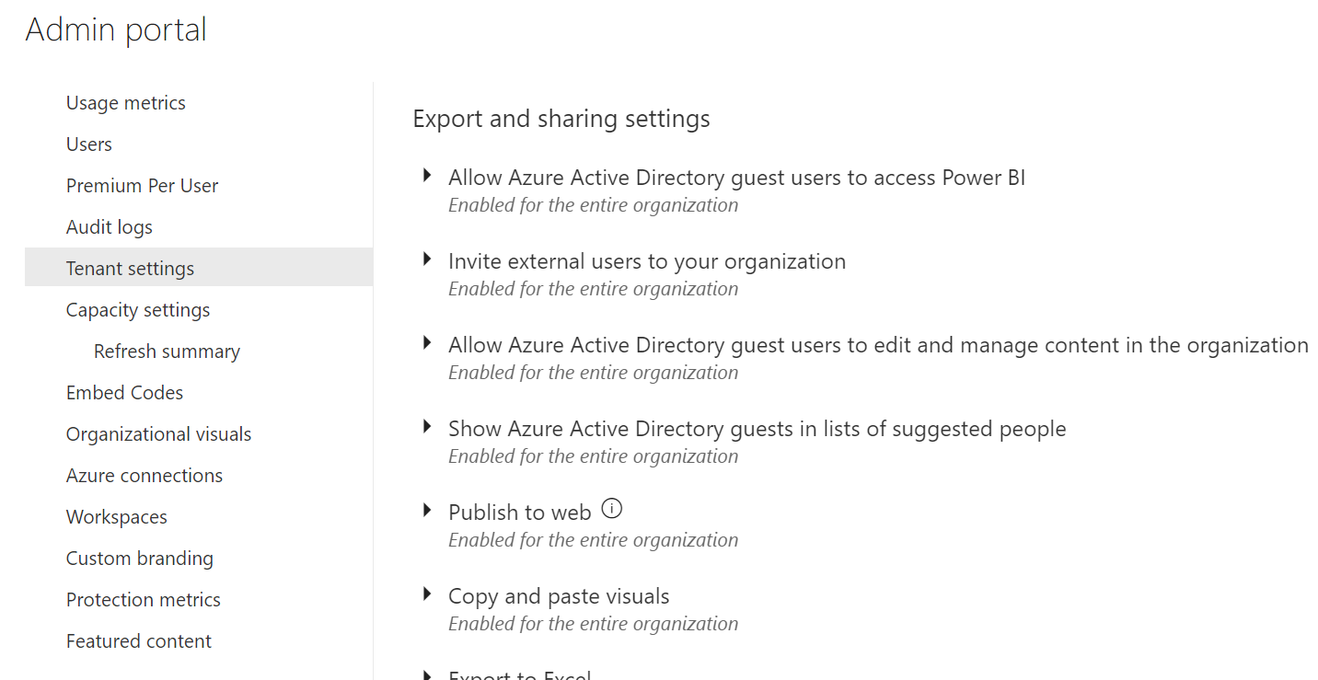
Configure Tenant Settings
Part of Power BI Admin Portal
Global Admin or Power BI Service Administrator or Power Platform Service Admin
Provides for granular settings
Controls tenant level operations
Example: You can disable Publish to Web!
© 2022 Microsoft. All rights reserved.

Slide 14
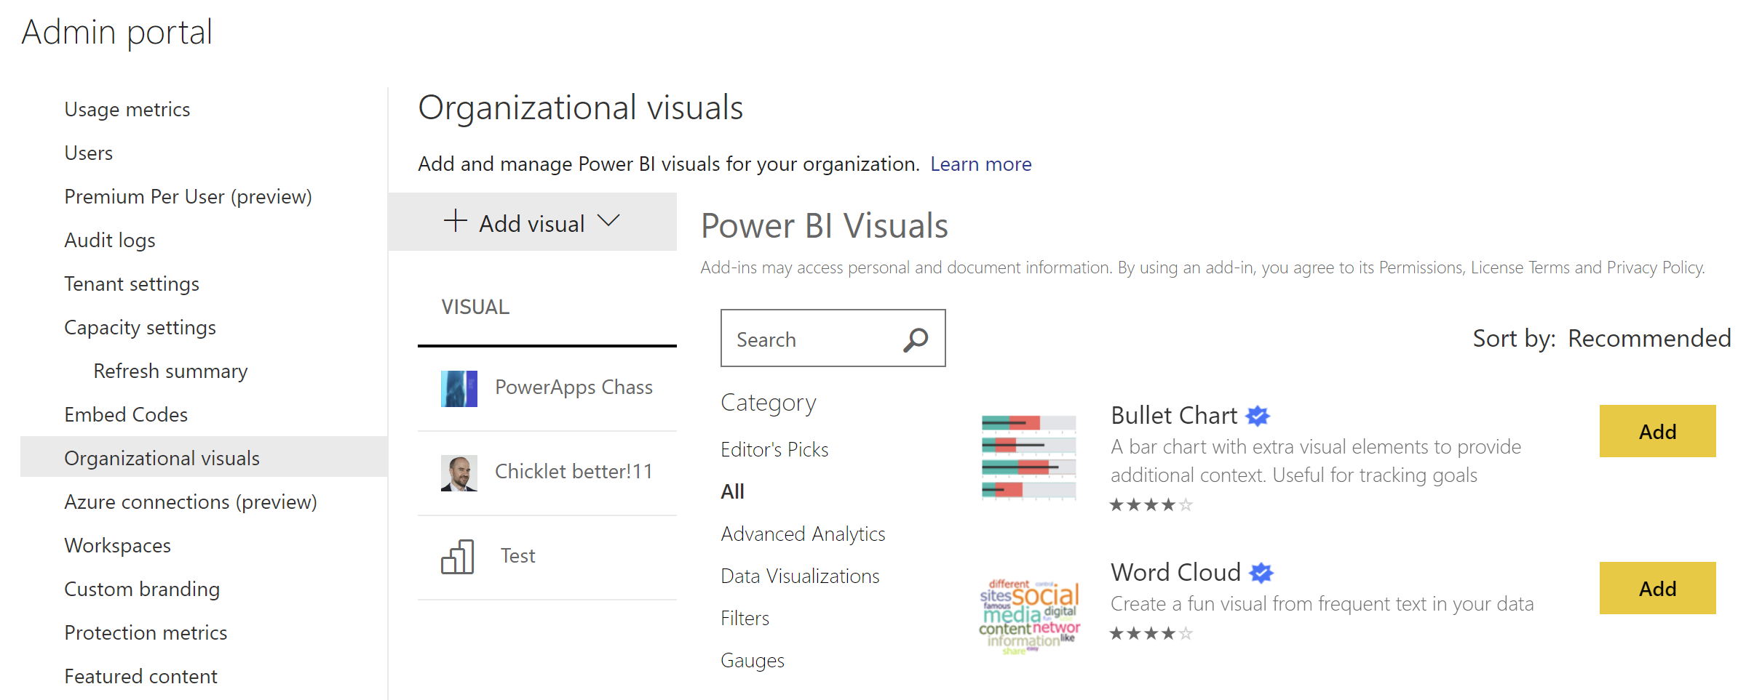
Deploying Organizational Visuals
Managed in Power BI Admin Portal
Establish approval process for usage of custom visuals
Used to distribute internal custom visuals to organization
Can also list blessed custom visuals
© 2022 Microsoft. All rights reserved.

Slide 15
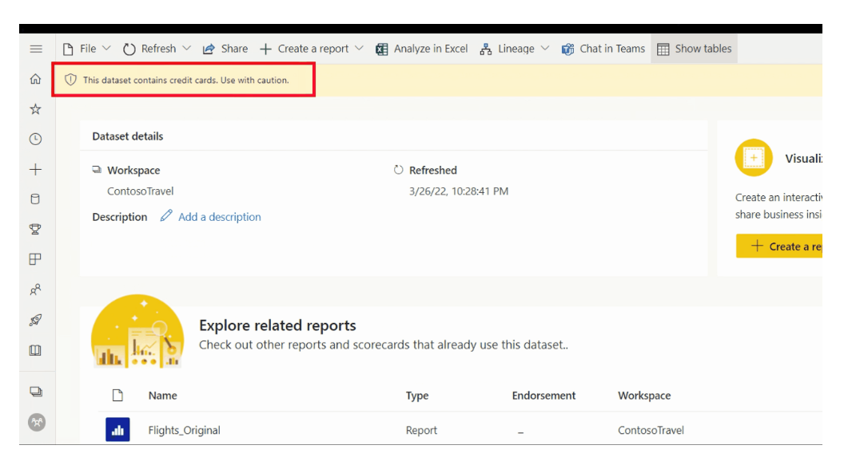
Detect Usage of Sensitive Info
Public preview of new Microsoft 365 DLP policies for Power BI premium workspaces
Supports automatic detection of sensitive data upload for data that has specific sensitivity labels applied
Admin can trigger automatic risk remediation actions such as alerts to security admins and/or customizable policy tips for end users

Slide 16
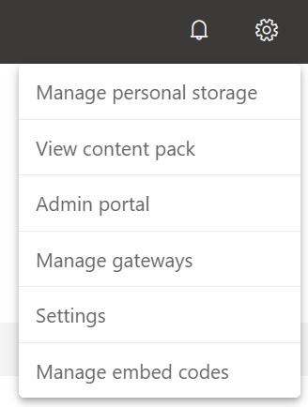
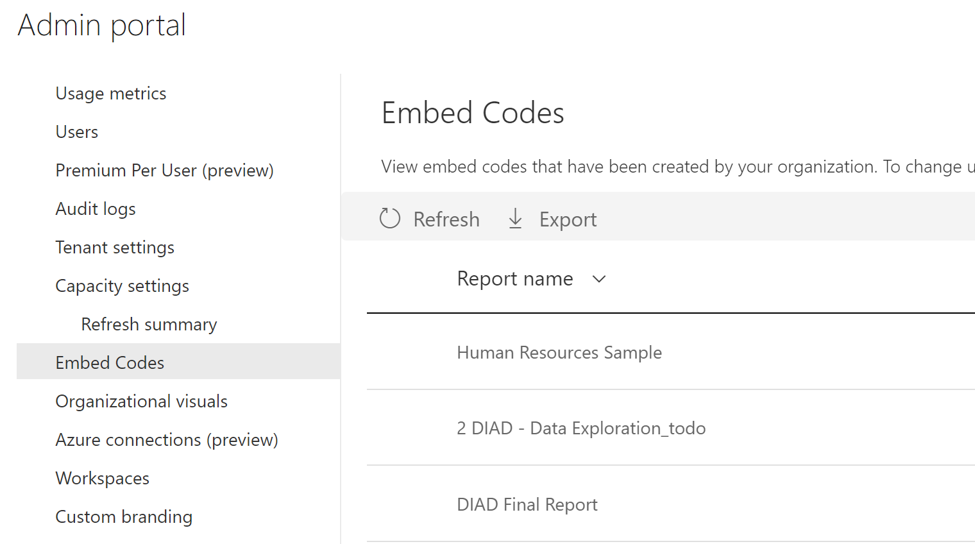
Managing Embed Code
Embed codes generated from Publish to Web
Users can manage their own embed codes
Admins can control all embed codes in tenant through Admin Portal
© 2022 Microsoft. All rights reserved.

Slide 17
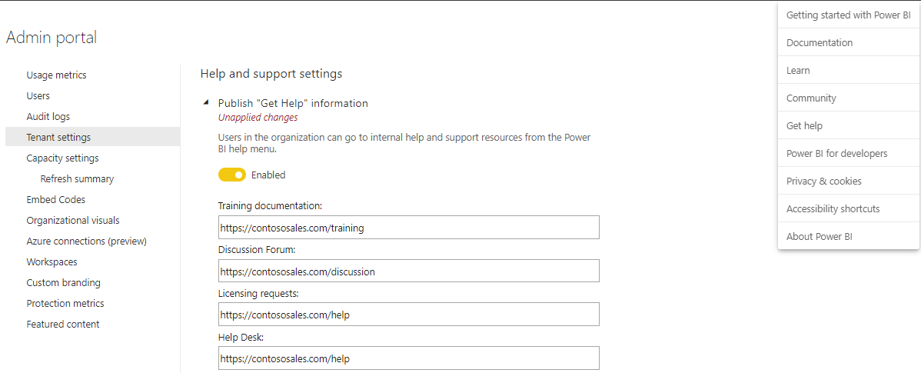
Help and Support Settings
Power BI customizes help and support links in help menu to point your users to specific organizational content
In Admin Portal ->Tenant settings -> Publish “Get Help” information toggle the Disabled button to Enabled, and then provide appropriate URLs to your company’s sites for training documentation, discussion forums, and help desk
© 2022 Microsoft. All rights reserved.

Slide 18
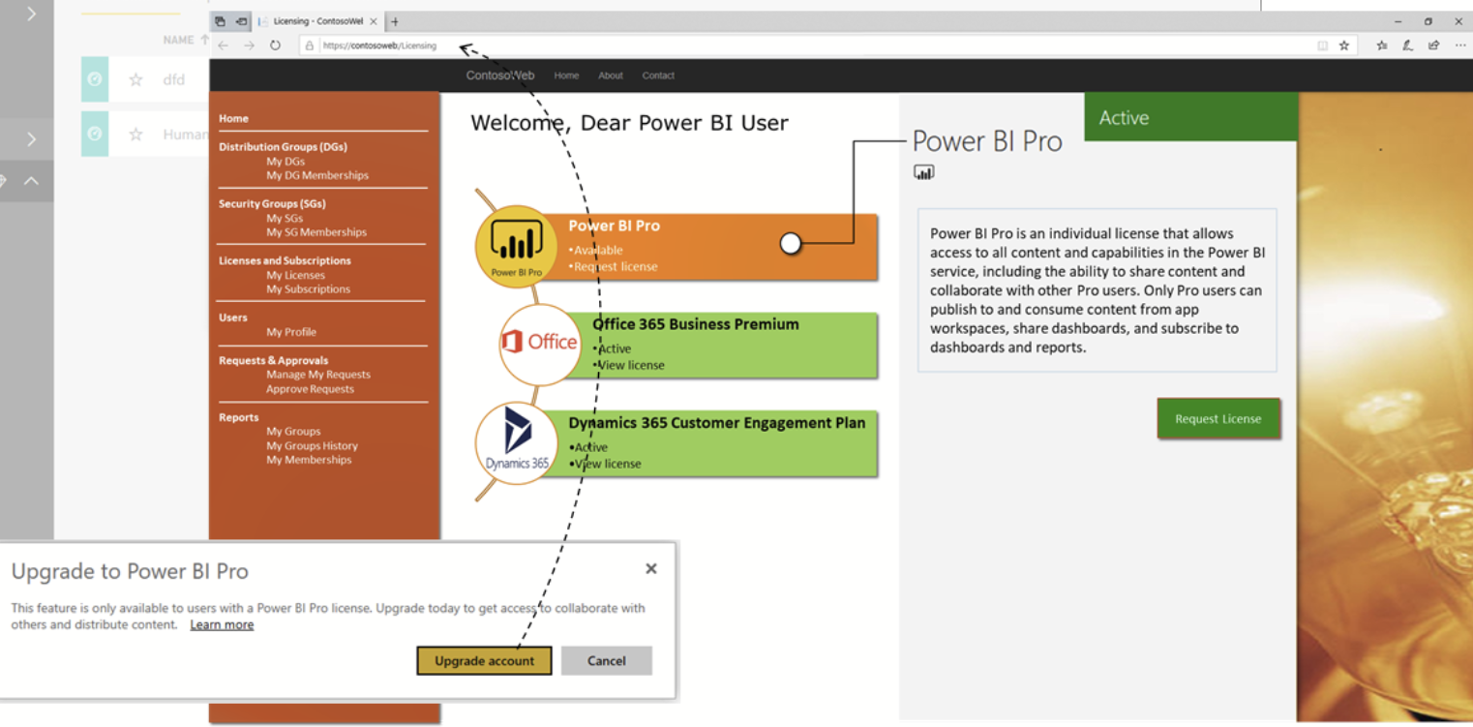
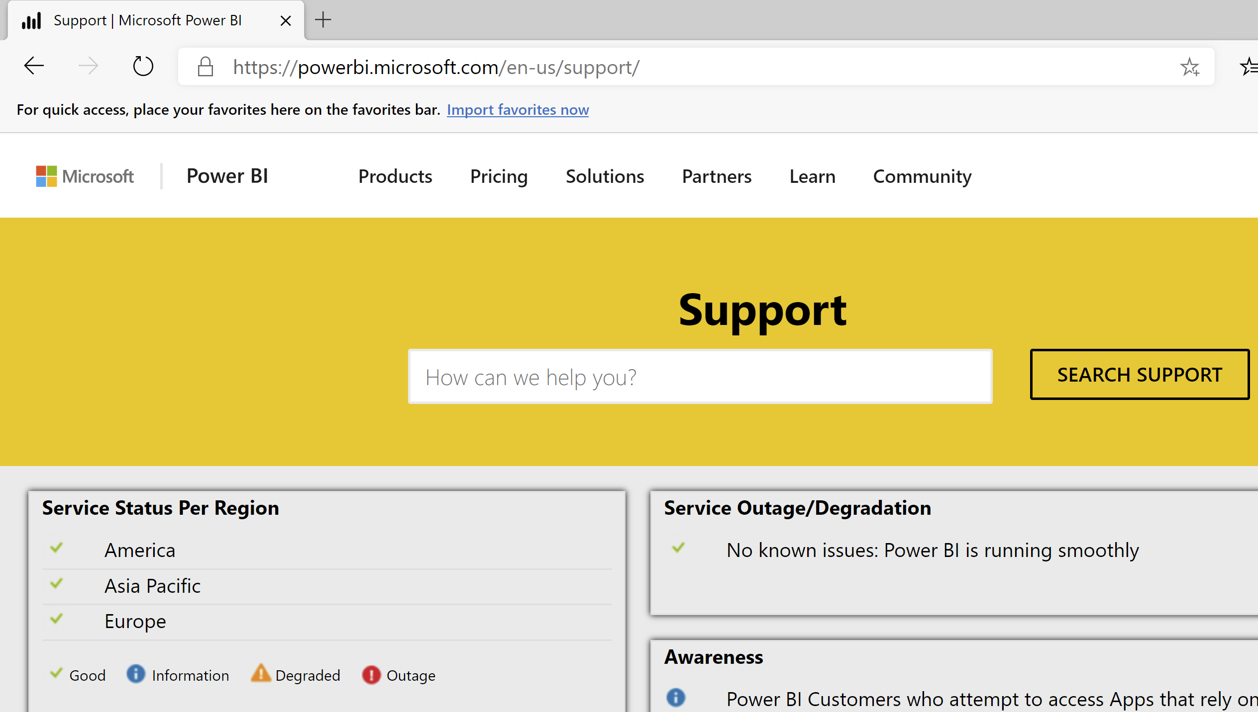
Help and Support Settings
Customize the link to acquire a Power BI license
Customize the target URL of the Upgrade account button
Guides users through the process defined in your organization
For Power BI Support and status use https://support.powerbi.com/
© 2022 Microsoft. All rights reserved.
Notes:
In the Tenant settings, note also that you can customize the link to acquire a Power BI license as well! In other words, can now direct your Power BI users to an internal website or application for license management, as depicted in the screenshots below. By specifying a URL for licensing requests, you customize the target URL of the Upgrade account button that a user without a Power BI Pro license can find in the Update to Power BI Pro dialog box as well as in the Manage personal storage page. Moreover, Power BI no longer offers the Try Pro for free button in this dialog box or storage page to ensure that Power BI guides your users reliably through the processes defined in your organization via your license management solution.
And that’s it for a quick introduction of the new help and support settings. Whether your company covers technical training and support in-house or outsources these functions to an external entity, you can now leverage your help and support resources directly from within Power BI to ensure employee productivity and satisfaction. Not only can you guide your users to an internal training site, connect them with experts and peers in your organization, and offer technical support through your own helpdesk team, you can also keep track of support incidents more easily, identify recurring problems, and build up a targeted knowledge base. Tailoring help and support for Power BI users can deliver a significant business value, enabling employees to contact their Power BI admins for support or to obtain a required Power BI Pro license more effortlessly than before.

Slide 19
Establishing a Power BI Environment
© 2022 Microsoft. All rights reserved.

Slide 20


The Tenant/Your Organization
Microsoft 365 Bubble
Azure Active Directory is the foundation
Shared accounts and groups
Includes subscriptions and licenses
Azure Active
Directory
Microsoft 365
Power BI
© 2022 Microsoft. All rights reserved.

Slide 21
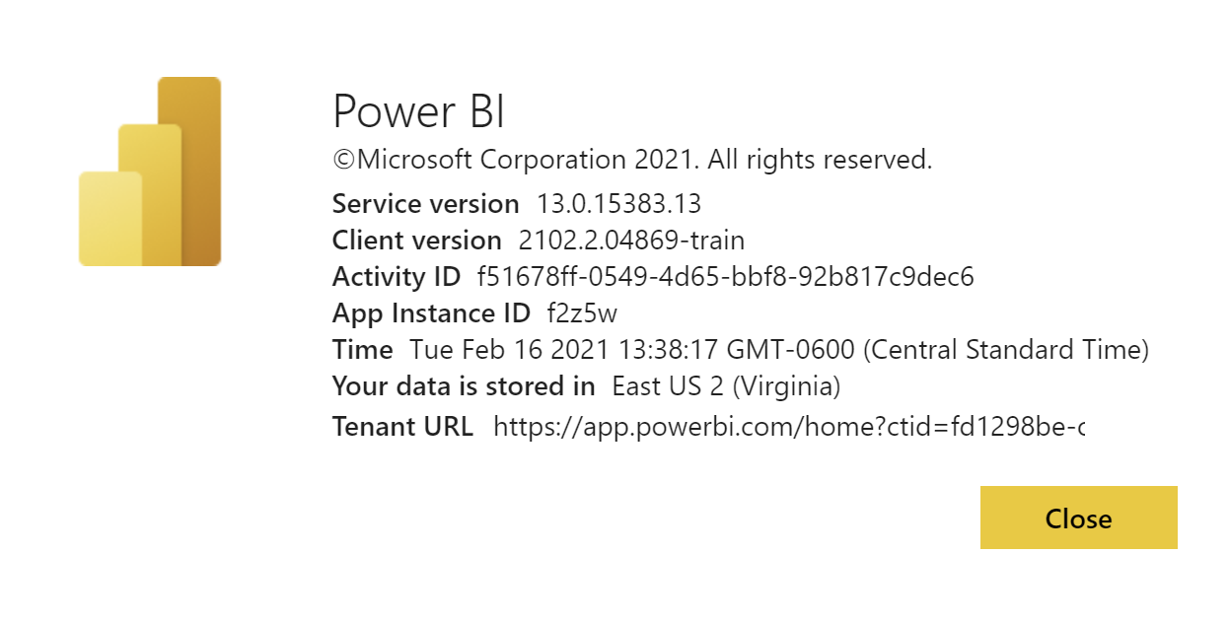
Choosing Your Data Center
Power BI Tenant created in Azure Data Center
Not possible to select Power BI location directly (more on this later)
Based on Office 365 country or Azure Active Directory data center
Think about other Azure services! Could result in egress charges!
© 2022 Microsoft. All rights reserved.

Slide 22
User Accounts vs Guest Accounts
User Accounts
Exist within the organization
Can create and consume content based on access and license
Mobile app can be used
Guest Accounts
External to the organization
Part of Azure AD B2B & B2C
Can consume, edit and manage content
Must have direct URL to shared content
Can be consumer accounts (@outlook.com, @Hotmail.com, @gmail.com)
Mobile app can be used
© 2022 Microsoft. All rights reserved.

Slide 23
Licensing
Power BI Desktop
Power BI Pro
Power BI Premium
App download
Licensed by user
Licensed by user
Licensed by capacity
Free report authoring and ad-hoc data exploration
Quick, easy-to-use self-service analytics for users requiring collaboration, dashboard sharing, ad hoc analysis, and report publishing
All the capabilities of Power BI Pro with Premium per user with Premium feature performance
An add-on to Power BI Pro for projects requiring large scale data, demanding performance, and the ability to distribute content without requiring per user licensing
© 2022 Microsoft. All rights reserved.

Slide 24
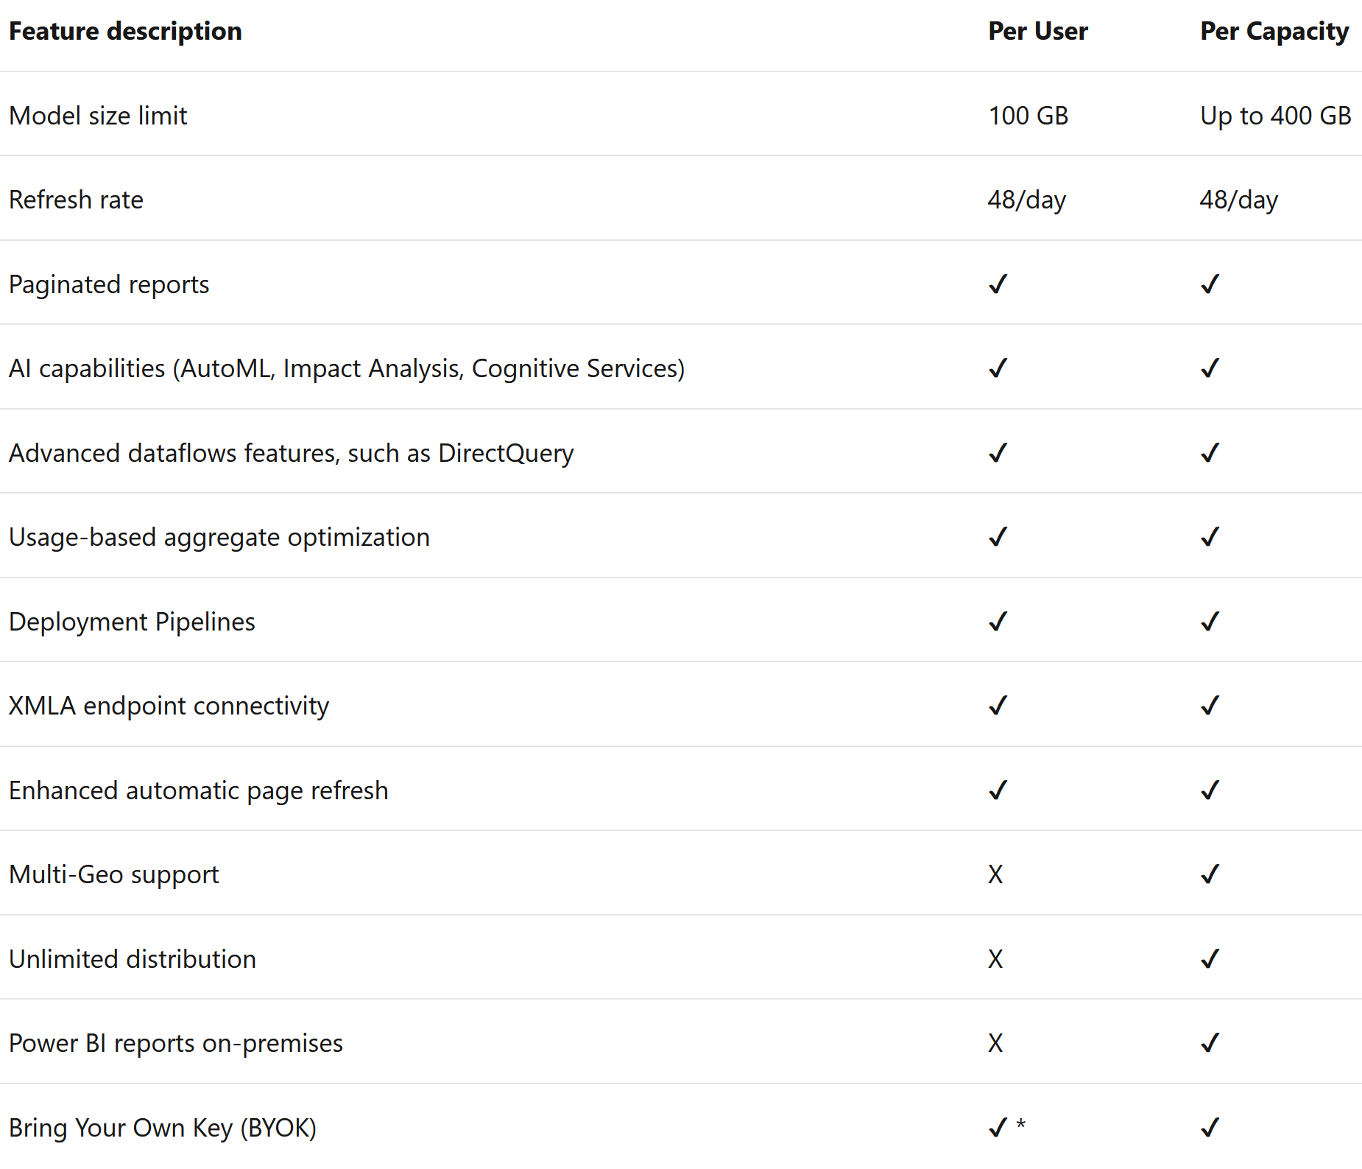
Power BI Premium Feature Comparison
© 2022 Microsoft. All rights reserved.

Slide 25
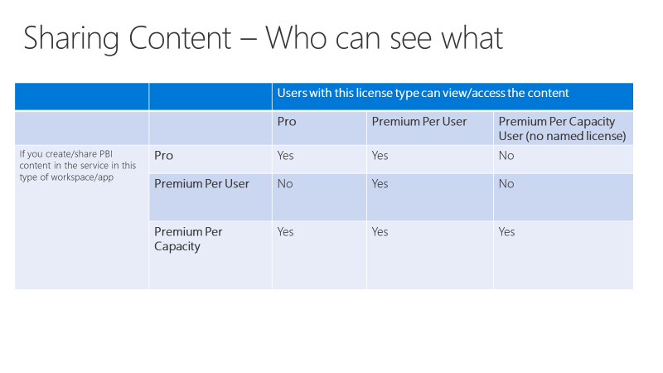
Power BI Premium per User (PPU)
New way to license premium features on a per user basis
Includes capabilities of Pro
No dependency on authors publishing to Premium
PPU can be turned on for any workspace
User must have PPU license to access Premium Per user workspace
© 2022 Microsoft. All rights reserved.

Slide 26
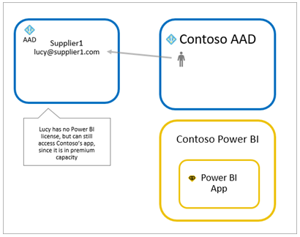
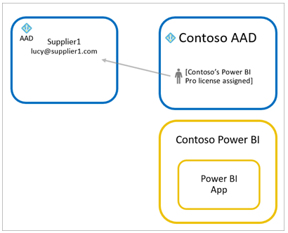
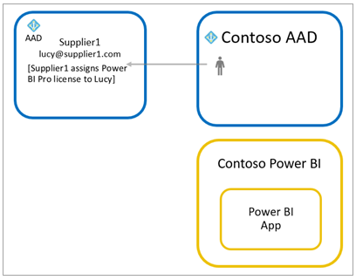
Guest Licensing
Use Power BI Premium
Power BI Pro to guest user
Bring Own Power BI Pro
© 2022 Microsoft. All rights reserved.

Slide 27
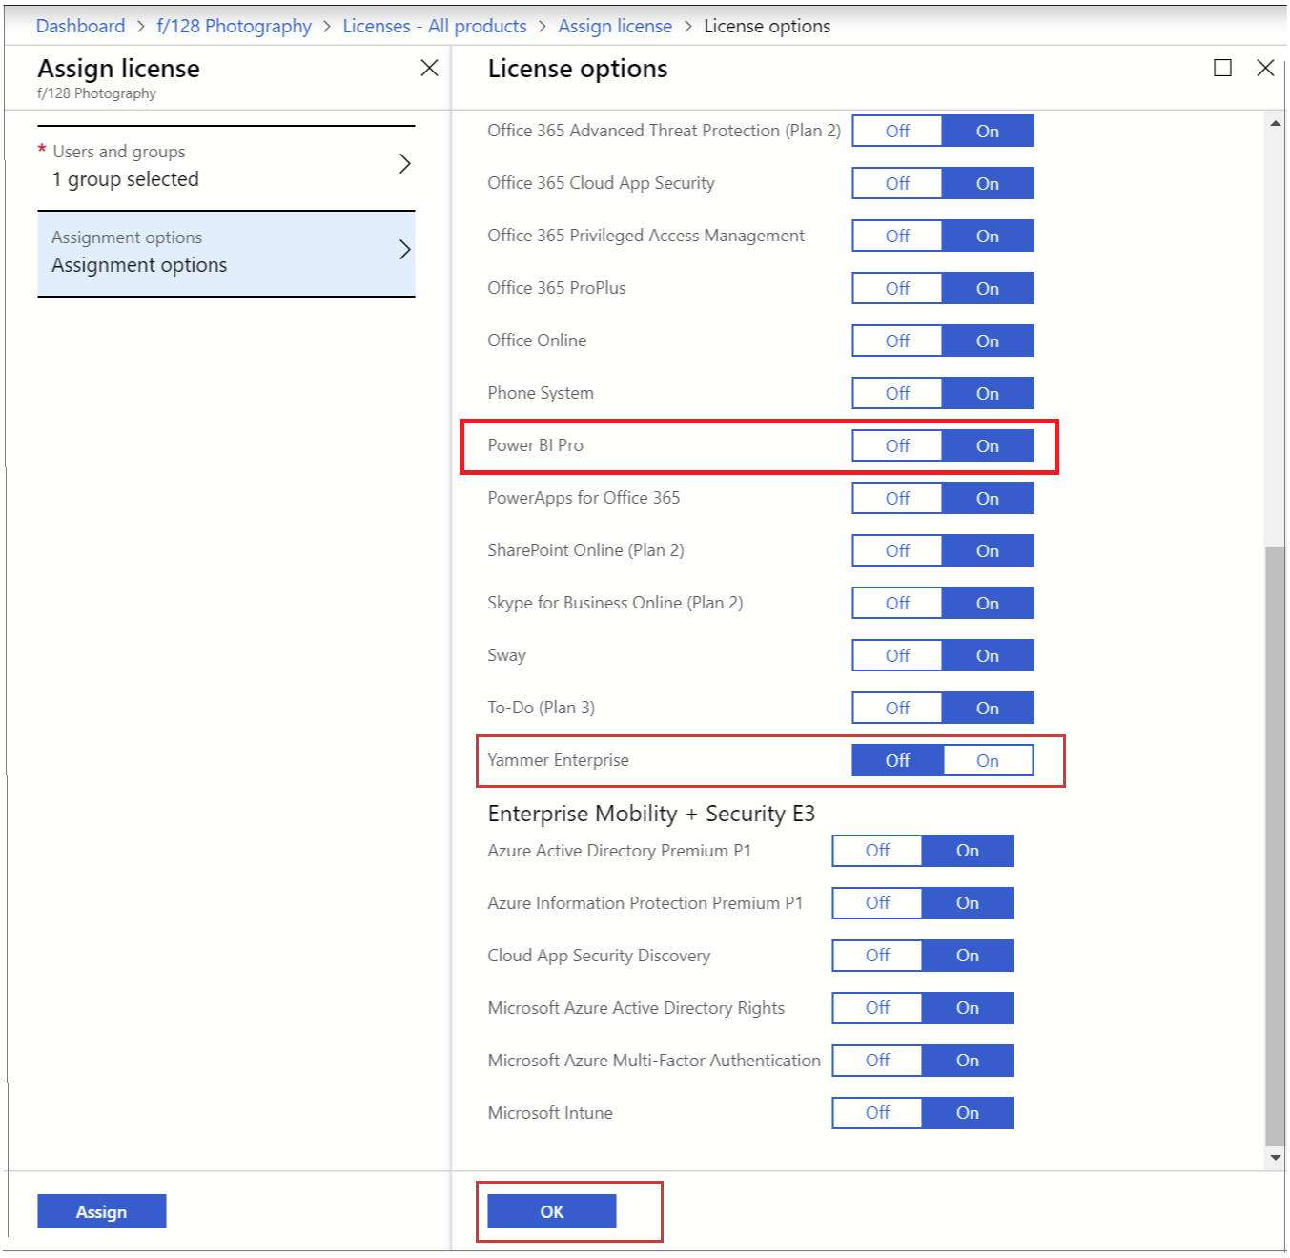
License Assignment
Power BI (Free) assigned with viral sign-up
Assigned via O365 Admin Center, Azure Portal or PowerShell
Group based licensing through Azure Active Directory
© 2022 Microsoft. All rights reserved.

Slide 28
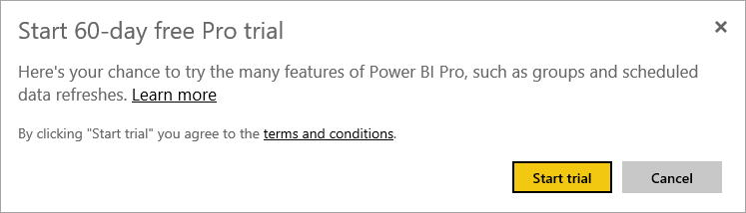

Understanding Pro Trials
Two Pro trials
60 day In Service trial
30-day Power BI Pro trial within O365 Admin Center (25 Licenses)
In service trial is an individual opt-in scenario
Admins can block or revoke
In service trial may opt in during user sign up if user doesn’t exist
When trial expires, user is reverted to a non-Pro experience
© 2022 Microsoft. All rights reserved.

Slide 29
Premium Per User Trials
Two Premium Per User trials
In Service trial
Premium Per User trial within O365 Admin Center
Any user can access In Service trial
Trial experiences through O365 can be enabled through the portal
© 2022 Microsoft. All rights reserved.

Slide 30
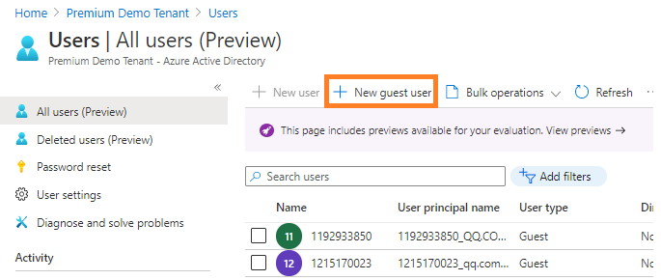
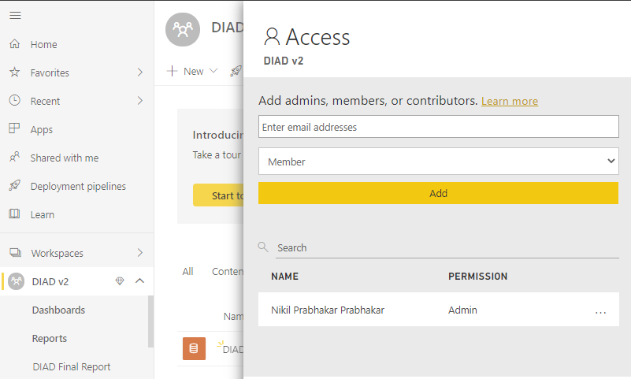
Configuring B2B Trust/Enabling & Monitoring
Power BI integrates with Azure Active Directory Business to Business to allow secure distribution of Power BI content to guest's users, while still maintain control and governing access
Planned invites for large number of users using PowerShell
Add the user in Azure AD as a new guest user
Edit invitation to be sent
Or
Add user directly to the Power BI workspace
© 2022 Microsoft. All rights reserved.

Slide 31
Demo
Establishing Roles & Licensing
© 2022 Microsoft. All rights reserved.

Slide 32
Facilitating Collaboration and Sharing
© 2022 Microsoft. All rights reserved.

Slide 33
My Workspace vs Workspaces vs Apps
My Workspace
Personal sandbox for individual user
Every user has this
IF IN DOUBT DO NOT USE
Workspace
Workspace used for collaboration
Can be specific to a team or subject area
When in doubt, use this!
Pro feature
Apps
Based on the workspace, packaged content and publishes/shares
Used for broad distribution of consumable content (View only)
May require Pro license if not backed with Premium
Apps can be pushed to groups
https://powerbi.microsoft.com/en-us/blog/duplicating-workspaces-by-using-power-bi-cmdlets/
© 2022 Microsoft. All rights reserved.

Slide 34
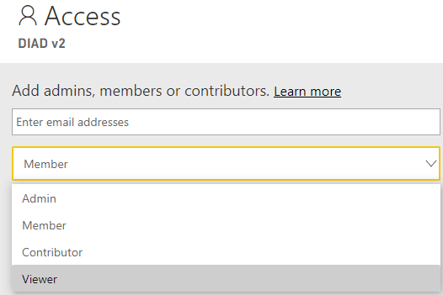
Workspaces Evolved
Old Workspaces​
Bound to O365 Modern Group (Shared with Teams, SharePoint, OneDrive…)​
Only individuals could be listed​
Can list Admins and Members (All members have edit or read rights)​ ​
Improved Workspaces​
Not bound to O365 Modern Group​
Can include individuals and security groups​​
© 2022 Microsoft. All rights reserved.

Slide 35
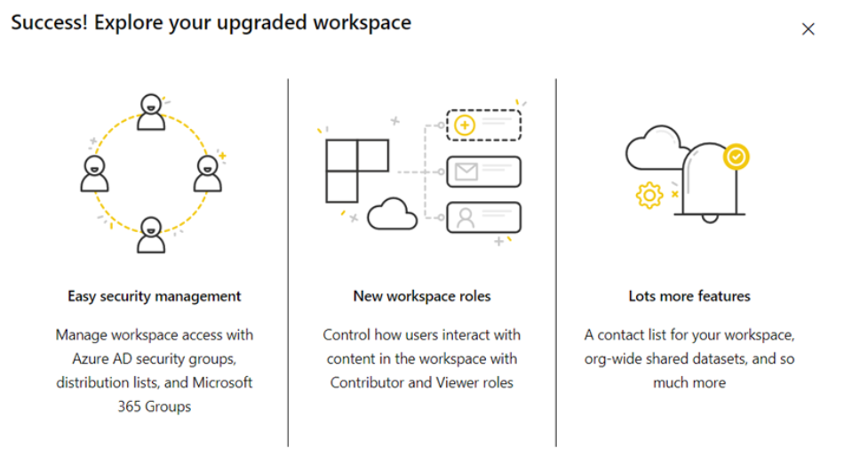
Upgrade Old Workspaces to New Workspaces
Any workspace admin or a Power BI admin, you can upgrade any classic workspace.
New workspaces have more granular workspace roles so you can better manage access to content
More flexibility managing upgraded workspaces because they're more loosely connected to their original Microsoft 365 group

Slide 36
Improved Workspace Experience
Create Workspace
Does not create an Office 365 Group
Workspace is only available in Power BI
Group Membership
Allows all kinds of user groups
Security, Email enabled security, Distribution lists, Office 365 groups, individual users
New Workspace roles
Migration
Staged migration with opt-in migration at GA
Required migration post GA
No support for content packs
Power BI Admins
Power BI Admin controls who can create workspaces
APIs/Rest for managing workspaces (e.g. enumeration, recovering, assigning owners)
© 2022 Microsoft. All rights reserved.

Slide 37
Impact to Power BI Users
Side by side: Workspaces v1 and v2
Will live side by side during preview and before migration completes
Different permissions possible on different kinds of workspaces
Setting WSv2 permissions won’t change O365 Groups membership
Migration will be required
Manual migration possible during preview (recreate)
Opt-in migration will be available at GA
Post GA* mandatory migration * Mandatory migration will happen as soon as Microsoft is working to ensure this change will not break many customers current set up.
© 2022 Microsoft. All rights reserved.

Slide 38
Permissions in Workspaces v2
Admin
Contributor
Can change and delete workspaces
Add Admins
Everything a Member can do
Add/edit/delete content within the workspace
Everything a Viewer can do
Member
Viewer
“Reshare” – add new users to be Members or lower permissions
Publish and update Apps
Everything a Contributor can do
View content within the workspace
Replaces read-only workspaces
© 2022 Microsoft. All rights reserved.

Slide 39
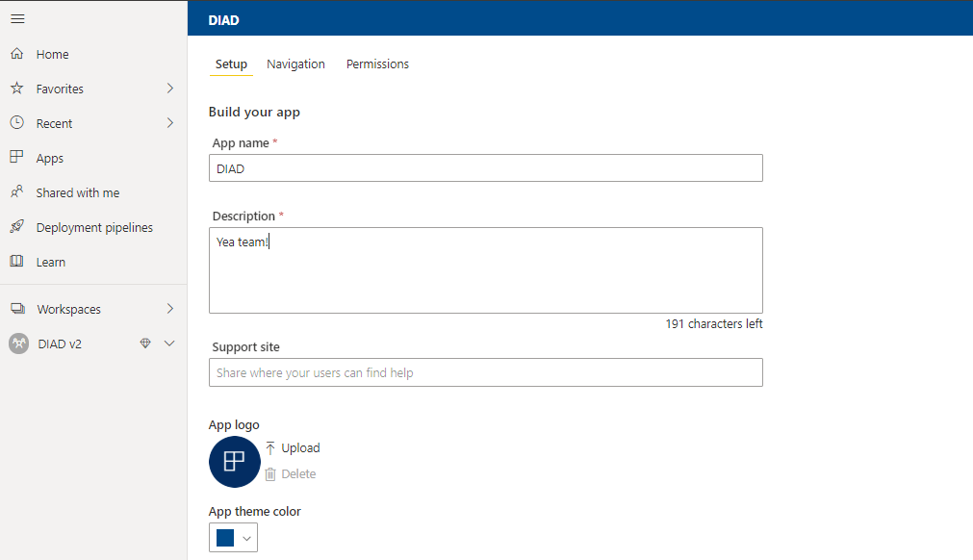
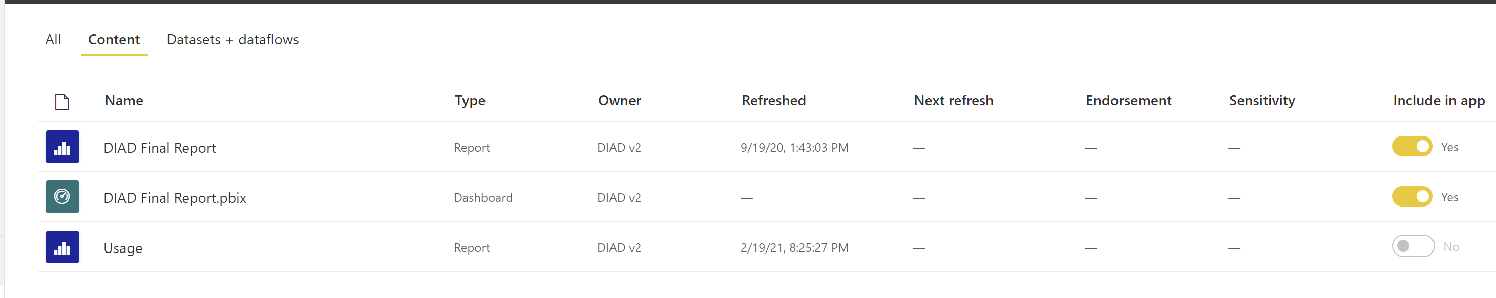
Power BI Apps
© 2022 Microsoft. All rights reserved.

Slide 40
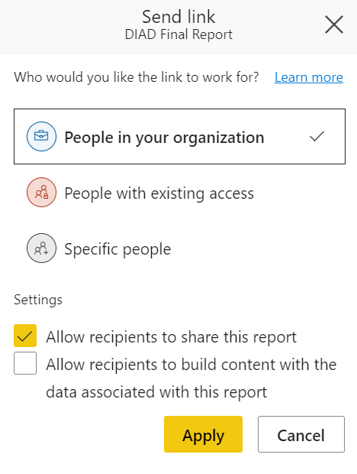
Sharing
Can share Reports and Dashboards
Share can be to external users by way of Azure AD B2B and B2C
Sharing to external users can be disabled in Tenant settings
Access can be revoked by content owner
© 2022 Microsoft. All rights reserved.

Slide 41
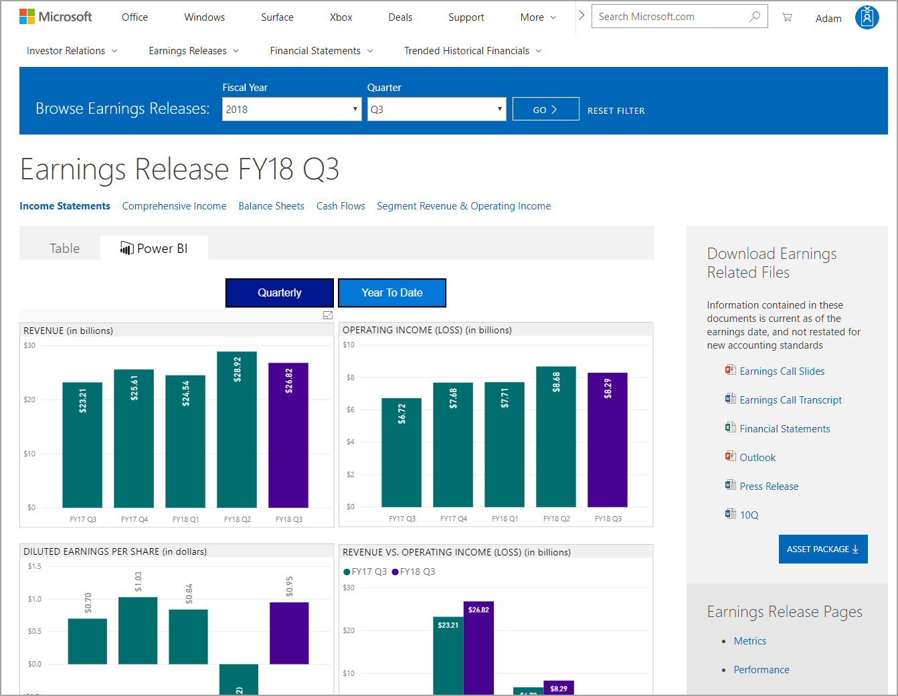
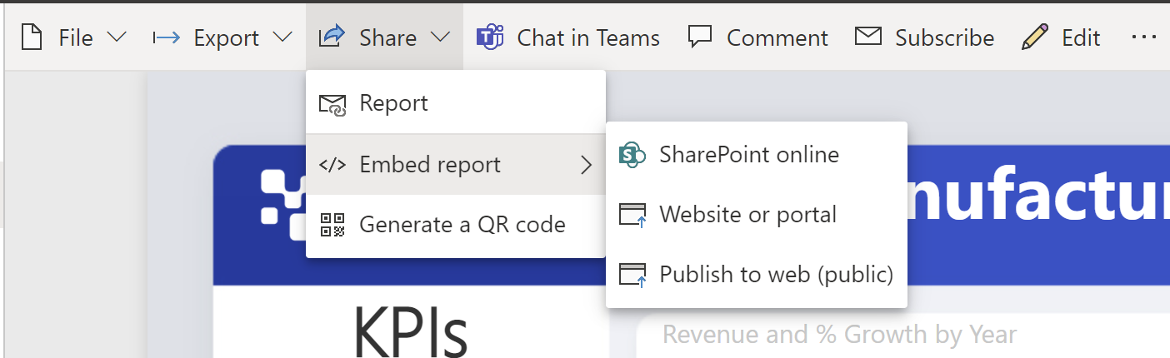
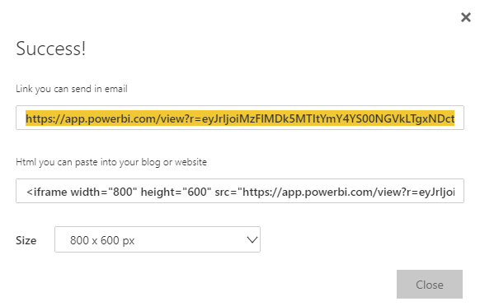
Publish to Web
Covered in more depth later
Generates Embed code
No authentication required (not secure!!!)
Great for Public Relations!
© 2022 Microsoft. All rights reserved.

Slide 42
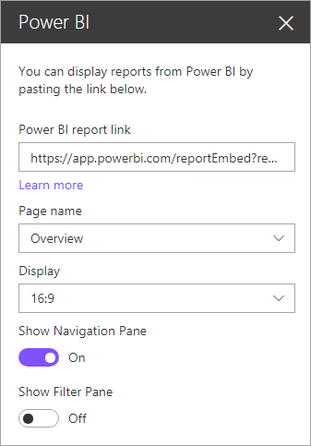
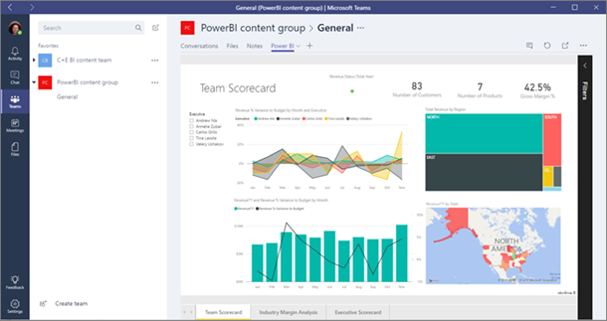
Embedding and Linking in Portals
Embedding via SPO Web Part or Teams integration
URLs to shared content can be listed in emails or on web sites
Will be reviewed in detail later today
© 2022 Microsoft. All rights reserved.

Slide 43
Data Sensitivity Labels
Power BI can integrate with Microsoft Information Protection and Microsoft Cloud App Security to provide greater control and visibility over sensitive data in Power BI
Certain users/security groups can classify and apply sensitivity labels to their Power BI dashboards, reports, datasets, and dataflows
All members of the organization can see those labels
Data sensitivity labels promote data protection by making Power BI authors and consumers aware of data sensitivity
Power BI data that has a data sensitivity label is exported to an Excel, PowerPoint, or PDF file and its data sensitivity label goes with it
© 2022 Microsoft. All rights reserved.

Slide 44
Data Privacy
Privacy levels specify an isolation level that defines the degree that one data source will be isolated from other data sources
Setting | Description | Example Data Sources
Private data source | A Private data source contains sensitive or confidential information, and the visibility of the data source may be restricted to authorized users. Data from a Private data source will not be folded to other sources (not even to other Private sources) | Facebook data, a text file containing stock awards, or a workbook containing employee review information
Organizational data source | An Organizational data source limits the visibility of a data source to a trusted group of people. Data from an Organizational data source will not be folded to Public data sources, but may be folded to other Organizational data sources, as well as to Private data sources | A Microsoft Word document on an intranet SharePoint site with permissions enabled for a trusted group
Public data source | A Public data source gives everyone visibility to the data contained in the data source. Only files, internet data sources, or workbook data can be marked Public. Data from a Public data source may be freely folded to other sources | Free data from the Microsoft Azure Marketplace, data from a Wikipedia page, or a local file containing data copied from a public web page
© 2022 Microsoft. All rights reserved.

Slide 45
Demo
Collaboration and Sharing
© 2022 Microsoft. All rights reserved.

Slide 46
Usage Monitoring and Auditing
© 2022 Microsoft. All rights reserved.

Slide 47
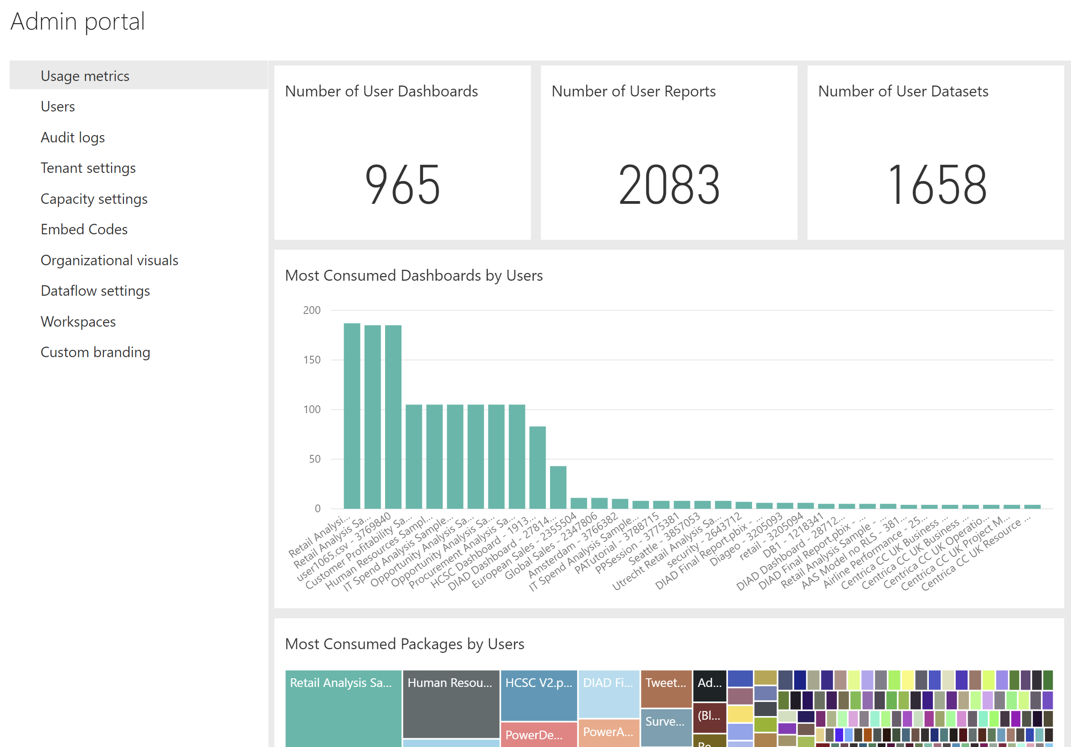
Admin Portal – Usage Metrics
Some of the information on there is useless (eg. “packages”)
Not usage by month, but most active report/dashboard creators
New admin usage metrics are constantly released
© 2022 Microsoft. All rights reserved.

Slide 48
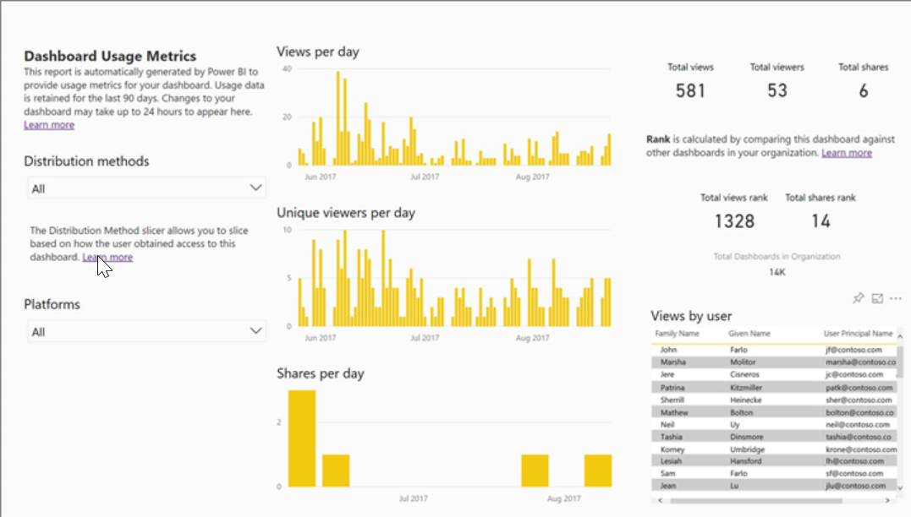
Usage Metrics for Dashboards & Reports
Ability to see usage of individual dashboards and reports
May differ from audit log numbers due to how it is collected
Can create reports with underlying dataset
© 2022 Microsoft. All rights reserved.

Slide 49
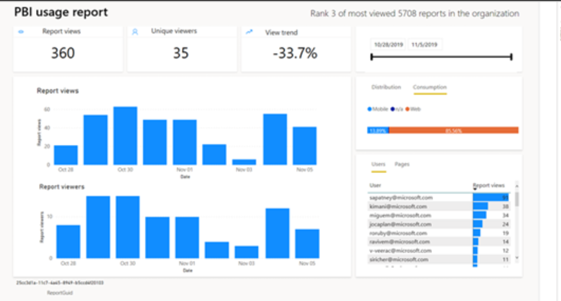
Usage Metrics for Dashboards & Reports – New Version
Will only be available in v2 workspaces
Will contain basic perf numbers for reports
Built on top of a brand-new infrastructure for collecting and storing usage information – more reliable, more scalable, and based on audit events, so no inconsistencies any longer between audit log and usage metrics report
© 2022 Microsoft. All rights reserved.

Slide 50
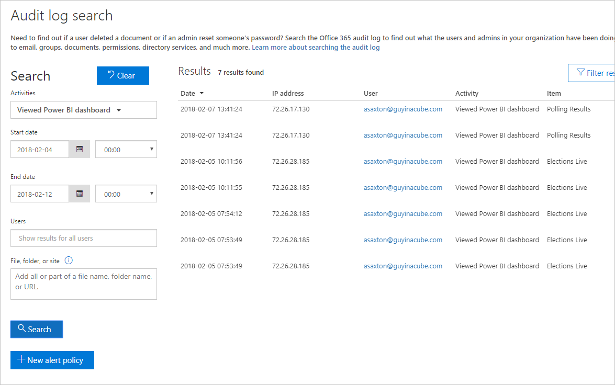
Audit Logs
Requires Exchange Online license
Disabled by default
Can use data to understand usage in Power BI Tenant
Data is retained for 90 days
In-Region Auditing
PowerShell access
© 2022 Microsoft. All rights reserved.

Slide 51
Activity Log
Activity Log is an API that helps Power BI service admins track user and admin activity
There are some key differences between audit log and Power BI activity log
Unified Audit Log | Power BI Activity Log
Includes events from SharePoint Online, Exchange Online, Dynamics 365, and other services in addition to the Power BI auditing events. | Only includes the Power BI auditing events.
Only users with View-Only Audit Logs or Audit Logs permissions have access, such as global admins and auditors. | Global admins and Power BI service admins have access.
Global admins and auditors can search the unified audit log by using Office 365 Security & Compliance Center, the Microsoft 365 Security Center, and the Microsoft 365 Compliance Center. | There’s no user interface to search the activity log yet.
Global admins and auditors can download audit log entries by using Office 365 Management APIs and cmdlets. | Global admins and Power BI service admins can download activity log entries by using a Power BI REST API and management cmdlet.
Keeps audit data for 90 days | Keeps activity data for 30 days (public preview)
Keeps audit data, even if the tenant is moved to a different Azure region. | Doesn't keep activity data when the tenant is moved to a different Azure region
© 2022 Microsoft. All rights reserved.

Slide 52
Demo
Usage Monitoring & Auditing
© 2022 Microsoft. All rights reserved.

